Slide 1
Introduction
As a globalized company with modern and advanced management concept, Britway was incorporated in 2000 in the province of British Columbia, Canada. By taking advantages of experienced management team who used to work in well know multinational companies for many years , Professional staff as well as wide connections with global industries, we have provided most cost effective solutions to our global customers in various sectors such as Electronics and telecommunications, Metals and metallurgical , Energy Conservation and Environment protection …etc.
Over the past 15 years, Britway has gradually become a bridge connecting the east and the west and the tie among product, talent people and working capital. With the business grows and expansion, especially the grows of resources business, A specialized entity -Britway Resources Inc was incorporated in 2015 in order to be more focus on resources business and and provide more professional services to our customers.
Britway Resources Inc is involved in the broad meaning resources integration business. In addition regular resources trading , We are also involved in the integration services in Technologies, Human resources and Capital as well. We are able to provide with total comprehensive solutions to our customers with our rich experience and competitive advantages, including Investment consultancies, direct & indirect investment in entire phases of a company growing from Angel investment, Venture capital to Private Equity investments.

Slide 2
We take natural resources, network resources and financial resources as a broad meaning resources. Through our code of conduct: People-oriented, Resources integration, Create value and Satisfy customers, we commit to provide our customers with best total solutions .
Britway Resources Inc is expecting to be your trustworthy partner in your Business growing way to the successful goal !

Slide 3
Advantages
Different from traditional trading and consulting Companies, Britway applies various
modern and advanced concepts of Marketing / Sales, Sourcing/Supply Chain
Management …etc in its routine operations.
People Oriented, Customer Maximum Satisfaction, Pursuit of Excellence , Six
Sigma...All of this builts up BTI's unique culture and competitive advantages:
A Sharp vision of Ensuring Customer Satisfaction and the Pursuit of Excellence.
Professional Team with talent people
---- Multi National living and working experiences, both Western and Oriental
Culture familiarities & Bilingual communication abilities
----- Leading Multi National companies working background and training
A deep penetration to global market & wide connections with the Industries
especially for Chinese technologies and Industries.
Global Network and operations
---- On-Site and real time services by our offices and networks in Canada, United States, Hong Kong, Mainland China.

Slide 4
Contact
Canada
6149 Empress Ave., Burnaby, BC , Canada, V5E2S4
Tel: +1 604 330 7736
Fax: +1 604 326 0156
Mail : info@britwayresources.com
Web : http://www.britwayresources.com
Hong kong
12/F., XiuHuaCommercial Building, 211-213 Jaffe Road , Hong Kong
Cheung Sha Wan, Kowloon, Hong Kong.
Tel: +852 23108000
Fax: +852 81482056
Mail: hk@britwayresources.com
Beijing
Room 305, Fortune Building,No.17 DaLiuShu Road, Haidian District, Beijing ,
China , Zip Code: 100081
Tel: +86 10 62114155
Fax: +86 10 62112476
Mail: bj@britwayresources.com

Slide 5
Services
Integrating our well trained and professional teams, we provide our customers
with value added services ,including:
Marketing & Sales Support
--- Market Analysis and Market Strategy Planning
--- Market Development
--- Products Sales Agents & Distribution Channels
Sourcing & Supply Chain Management
--- Supplier Identification, Assessment, Development and Management
--- Supplier Technical and Quality Support
--- Scheduling, WIP, Delivery control and related Commercial Services
---- Integrated Sourcing Services
As focal point to provide customer with Integrated Supplies by means of
consolidating customer diversified requests.
Cooperation or Joint Venture Consultancy
Commercial consulting for culture and technical cooperation and Joint Venture
Investment and financing Services
--- Trade and Project financing
--- Angel, VC and PE Investment

Slide 6
We are looking forward to establish reciprocal strategic long-term partnerships
with all customers, suppliers and other partners.
Britway Resources Inc will be
Your window to the outside world ; Your marketing and Sales team , Your Sales &
Distribution agency , Your Sourcing and Purchasing Team or Agents….etc .
Britway Resources Inc is also your consultant, Assistance and partners in
international cooperation and joint venture
Welcome to contact us for more information. Please email us your requests and
intention so as for our further communication and discussion.

Slide 7
Career
If you are a dynamic, talent, highly motivated individual and seeking a
challenging environment…
Britway Resouces Inc is for you!
We promise you will find a unlimited career space and platform to grow
substantially. Whether you are just embarking on your career or looking for a
new challenge, Britway Resources Inc has opportunities at all levels. We
provide our employees with career paths that give them the opportunity to learn
and grow with the company.
Please specify your position of interest by writing the exact job title ONLY (as it
appears in the posting) in the subject line of your e-mail.
Job Postings
Send us your resume, and we will contact you as soon as a suitable position
becomes available. We thank all applicants for their interest, however only
candidates under consideration will be contacted.

Slide 8
Product
we are able to provide our customers with various cost effective products and value-added services by means of our widely connections with global suppliers and our professional team, Including but not limited in the following
Nobel Alloys
Aluminum and related products
Other Resources Products

Slide 9
1.Nobel Alloys
Taking the advantages of close and wide connections with global industries, we are trading globally various kinds of Nobel Alloys and related metallurgical materials..
1.1 Vanadium Alloy
Vanadium with element symbol V and atomic number 23 is a silver-grey metal with good tractility and hardness, corrosion preventive, resistance to water, hydrochloric acid and sulfuric acid.
Vanadium alloys include Ferro Vanadium, Vanadium Carbon Nitride . Its raw material are Pentoxide Fused Flakes V2O5 , V2O3 ..etc.
1.1.1Ferro Vanadium
Ferro Vanadium is mainly used as an alloying agent in steel making. Ferro Vanadium forms stable carbides and nitrides that will result in a significant increase in strength, hardness, abrasion, and ductility of steel. Therefore Ferro vanadium is widely used in the production of Carbon Steel, High-strength Seel, Low- Alloy high -alloy steel, tool steel ..etc.
There are two kinds of Ferro Vanadium products -- FeV80 and FeV50

Slide 10
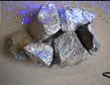
FeV80 Specifications：
Table 1：commodity and chemical composition
 | Chemical composition (mass fraction)/%
Commodity | V |  | C | Si | P | S | Al | Mn
 |  |  | No more than
FeV80 | 78.0~82.0 |  | 0.15 | 1.5 | 0.05 | 0.04 | 1.5 | 0.50
Size：block structure，size requirement should be consistent with table 2
Item |  | Size/mm |  | Less than the lower limit/% |  |  | More than the upper limit/%
 |  |  |  | No more than
1 |  | 10~50 |  | 3 |  |  | 7
2 |  | 10~100 |  | 3 |  |  | 7
3 |  | 10~150 |  | 3 |  |  | 7
Size inspection：According to GB/T 13247-1991
Packing:in100kg & 250kg steel drums or bags net weight

Slide 11
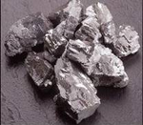
FeV50 Specifications ：
Table 1：commodity and chemical composition
 | Chemical composition (mass fraction)/%
Commodity | V |  | C | Si | P | S | Al | Mn
 |  |  | No more than
FeV50 | 48.0~55.0 |  | 0.4 | 2.00 | 0.06 | 0.04 | 1.5 | -
Size：block structure，size requirement should be consistent with table 2
Item |  | Size/mm |  | Less than the lower limit/% |  |  | More than the upper limit/%
 |  |  |  | No more than
1 |  | 10~50 |  | 3 |  |  | 7
2 |  | 10~100 |  | 3 |  |  | 7
3 |  | 10~150 |  | 3 |  |  | 7
Size inspection：According to GB/T 13247-1991
Packing:in100kg & 250kg steel drums or bags net weight

Slide 12
1.1.2 Vanadium Carbon Nitride VN (VCN)
VN(VCN) is a new kind of Alloying agent , which mainly made of vanadium nitrogen and carbon . It can be used in the production of micro-alloying steel,High strength Steel ..etc instead of Ferro vanadium so as to reduce the consumption of vanadium per tonnage steel.
Depending on the content percentage of nitrogen, the main products are VN12 and VN16.
VN12 Specifications：
Commodity and chemical composition
Commodity | Chemical composition (mass fraction)/%
 | V | N |  | C | P | S
VN12 | 77.0~81.0 | 10.0~14.0 |  | 《10.0 | 《0.06 | 《0.10
Note：Supplied can provide the test results of oxygen, aluminum, silicon, manganese content if needed.
Size：10~40mm,no more than 10mm《5%
Packing：In moisture-proof bag, 5kg or 10kg net weight, and then combined in to a steel drum.

Slide 13
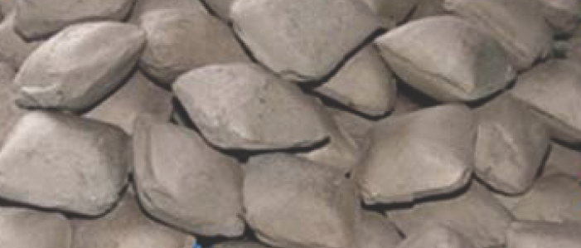
VN16 Specifications：
Commodity and chemical composition
Commodity | Chemical composition (mass fraction)/%
 | V | N |  | C | P | S
VN16 | 77.0~81.0 | 14.0~18.0 |  | 《6.0 | 《0.06 | 《0.10
Note：Supplied can provide the test results of oxygen, aluminum, silicon, manganese content if needed.
Size：10~40mm,no more than 10mm《5%
Packing：In moisture-proof bag, 5kg or 10kg net weight, and then combined in to a steel drum

Slide 14
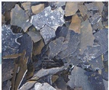
1.1.3 V2O5
It is the main raw materials for the production of Ferro Vanadium and Vanadiun Carbo Nitride . Moreover, it can be also used in chemical industry. The high purity V2O5 is also widely in Aviation and aerospace industry as well.
V2O5 Specifications：
Commodity
Chemical composition
Size
Packing
V2O5
V2O5
98% Min
5×50×50mm Max
200kg or 250kg steel drums net weight & 1MT bag
Si
0.25％ Max
Fe
0.30％ Max
P
0.05％ Max
S
0.03％ Max
As
0.02％ Max
Na2O＋K2O
1.50％ Max

Slide 15
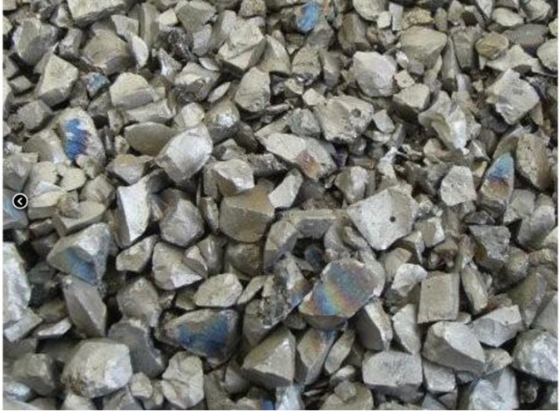
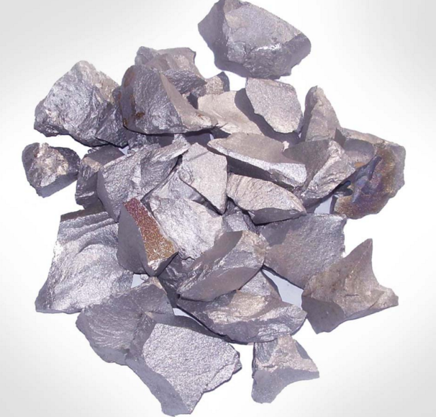
1.2 Titanium Alloy：
Titanium with element symbol Ti and atomic number is 22 is a silvery-white transition metal , Its main features are light in weight and high in strength, good corrosion resistance to sea water, aqua regia and chlorine..etc. Therefore it is know as “space metal “ for its thermo stability, low and high temperature resistance, acidproof, Alkali-resisting as well as other stable chemical properties.
Ferro Titanium is alloy of Titanium and iron , It is used in steelmaking as a cleansing agent for iron and steel.
Ferro Titanium specification：
Ferro Titanium
Ti | 40 or 70 | % min
Al | 0.5 or 4.5 | % max
V | 3 | % max
N | 0.2 or 0.5 | % max
S | 0.03 | % max
P | 0.04 | % max
C | 0.04 | % max
Mn | 1.5 | % max
Size | 10-50/10-100mm

Slide 16
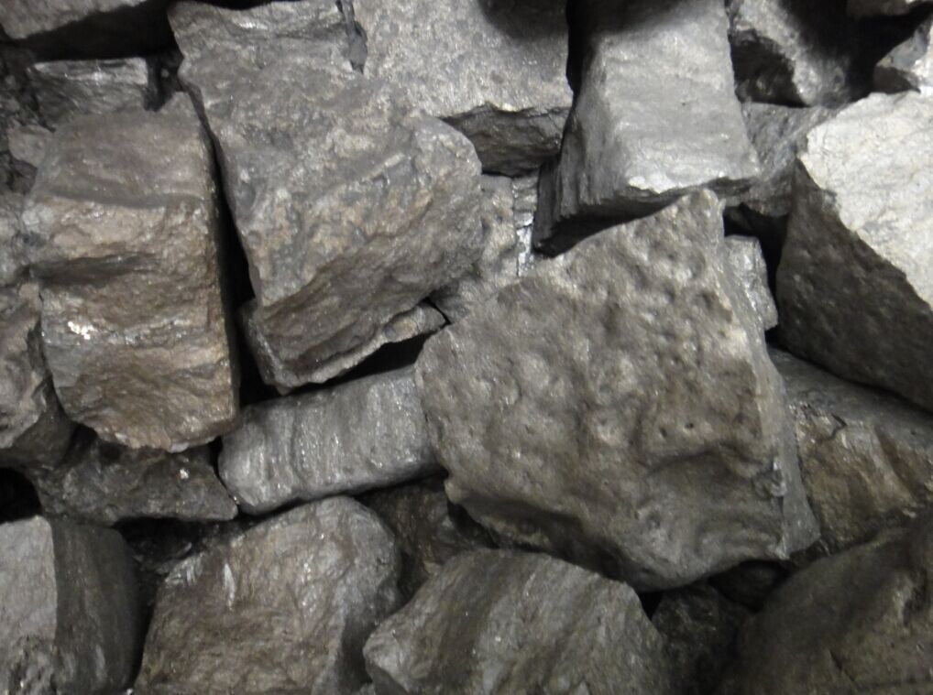
1.3 Tungsten Alloy (Ferro Wolfram )：
Tungsten (Wolfram ) with element symbol W, Atomic number 74 is an important alloying element in high-speed and other tool steels, and is used to a lesser extent in some stainless and structural steels.
Ferro Tungsten is an alloying agent in steel making and it is also a remarkably robust alloy because of its high melting point. Wolfram has the second highest melting point after carbon.
Ferro Tungsten Specification：
Ferro Tungsten
W | 75 | % min
C | 0.40 | % max
P | 0.05 | % max
S | 0.08 | % max
Si | 0.70 | % max
Mn | 0.50 | % max
Cu | 0.15 | % max
As | 0.10 | % max
Sb | 0.05 | % max
Sn | 0.08 | % max
Size | 10-50 mm 90% min
Packing | 250kg drums on pallets

Slide 17
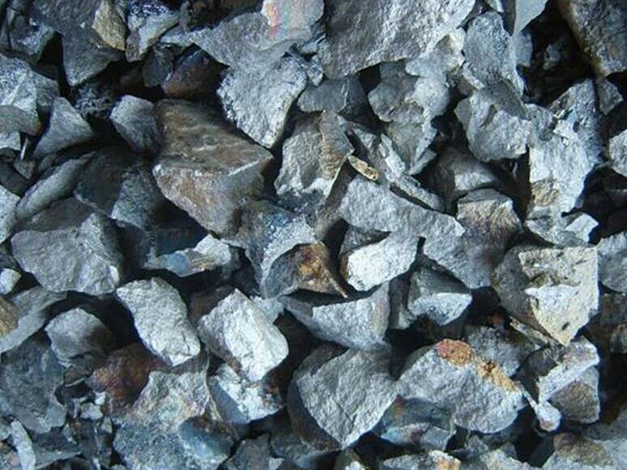
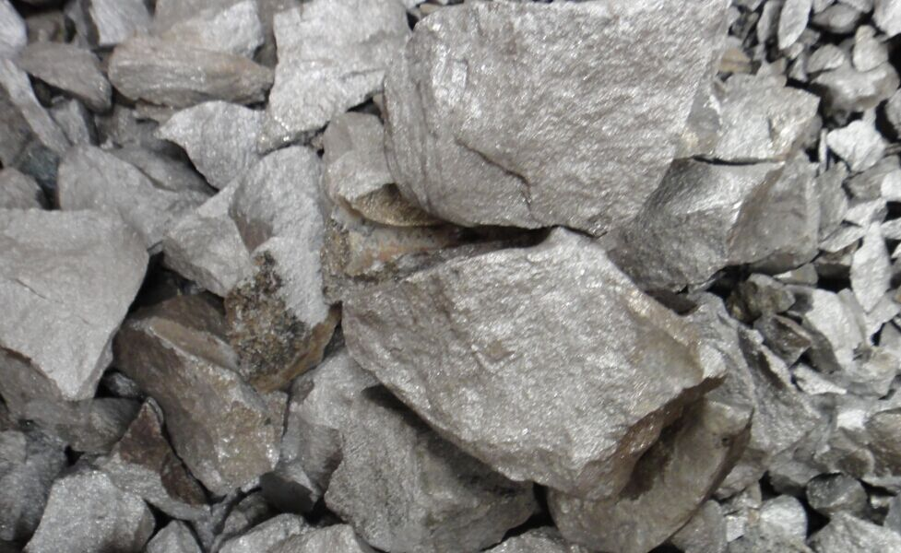
1.4 Molybdenum Alloy
Molybdenum with element symbol Mo and atomic number 42 is a silvery white metal with hard and tough feature.
Ferro Molybdenum is the main product of molybdenum alloy with 50%-60% Molybdenum. One of the primary benefits adding Ferro Molybdenum to an alloy is that it harden properties ,which makes steel extremely strong and at the same time weldable, Additionally, adding Ferro Molybdenum to an alloy can increase corrosion resistance. Therefore it is main agent to produce HSLA (High Strength-Low Alloy) steel and stainless Steel.
Ferro Molybdenum Specification：
Ferro Molybdenum
Mo | 60-65 or 67-70 | %
Cu | 0.50 | % max
Si | 1.50 | % max
S | 0.10 | % max
Cu | 0.10 | % max
P | 0.05 | % max
Size | 10-50/10-100 mm

Slide 18
1.5 Nobel Alloy conversion business：
In addition to direct trading and distribution of various nobel alloys made by
our global suppliers, Britway Resources Inc is able to convert from raw material
to final products for our global customers by our global leading convertors based
in China, South Korea and Canada .
We purchase high quality raw materials , convert in our qualified Conversion
Service providers , and provide our customers with various kind of products.
Main converted products are
- Vanadium Pen toxide Fused Flake V2O5
- Ferro Vanadium FeV80
- Vanadium Carbo Nitride VCN /VN

Slide 19
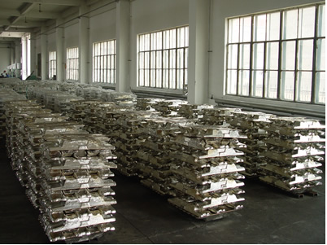
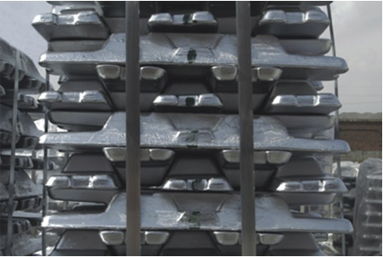
2.Aluminum and related products
Aluminum is the most abundant element in the earth and it is widely used in all walks of life due to its thermal conductivity, ductility and other features.
2.1 HP Aluminum Ingot
The high purity Aluminum is the product of which content of Aluminum higher
than 99.9% . It is widely used in the Appliance and Electronics industries,
National Defense ,Aerospace and information equipment industry etc.

Slide 20
There are different model of ingot products based on Aluminum content , Spec of ingot with Al more than 99.95% is as follows.
HP Aluminum Specification(GBT8644-2000)
Commodity | Chemical composition %
 | Al % no less than | Impurity no more than
 |  | Fe | Si | Cu | Zn | Ti | Other impurity | Total
Al99.996 | 99.996 | 0.0010 | 0.0010 | 0.0015 | 0.001 | 0.001 | 0.001 | 0.004
Al99.993 | 99.993 | 0.0015 | 0.0013 | 0.0030 | 0.001 | 0.001 | 0.001 | 0.007
Al99.99 | 99.99 | 0.003 | 0.003 | 0.005 | 0.002 | 0.002 | 0.001 | 0.04
Al99.95 | 99.95 | 0.02 | 0.02 | 0.01 | 0.005 | 0.002 | 0.005 | 0.05
注：
1. The content of Al is the calculated difference between 100% and the sum of the impurities as Fe, Si, Cu, Zn and Ti.
2. Other impurities that not list in the table, the buyer and the seller can negotiate if needed.
3. We use rounding comparison method for the determination of value analysis. According to the rules of GB/T8170, rounding digital should be the same as limit digital list in the table.

Slide 21
The spec of other Aluminum ingots with content of 99.0%-99.9% are as
following
Specification（GB/T1196-93）:
 | Chemical composition
Commodity | Al% no less than | Impurity no more than
 |  | Fe | Si | Cu | Ga | Mg | Others | Total
Al99.85 | 99.85 | 0.12 | 0.08 | 0.005 | 0.03 | 0.03 | 0.015 | 0.15
Al99.8 | 99.8 | 0.15 | 0.1 | 0.1 | 0.03 | 0.03 | 0.02 | 0.2
Al99.7 | 99.7 | 0.2 | 0.13 | 0.1 | 0.03 | 0.03 | 0.03 | 0.3
Al99.6 | 99.6 | 0.25 | 0.18 | 0.1 | 0.03 | 0.03 | 0.03 | 0.4
Al99.5 | 99.5 | 0.3 | 0.25 | 0.2 | 0.03 | 0.05 | 0.03 | 0.5
Al99 | 99 | 0.35 | 0.45 | 0.2 | 0.05 | 0.05 | 0.05 | 1

Slide 22
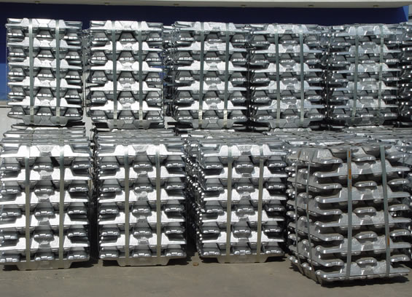
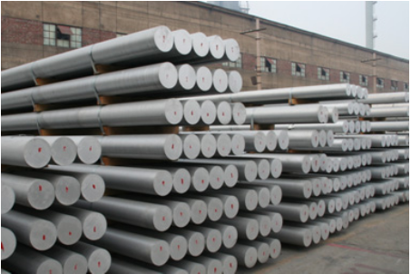
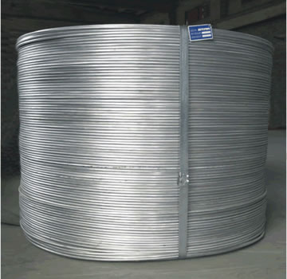
2.2 Aluminum Alloy
Various kinds of Aluminum Alloy are made by adding different elements into high
purity aluminum, it can be processed into type of ingot, slab ingot, plate, bar and
rod . They are widely used in electrical, automotive, transportation, aerospace
and other industries.

Slide 23
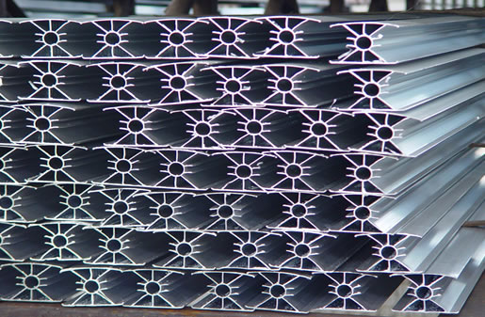
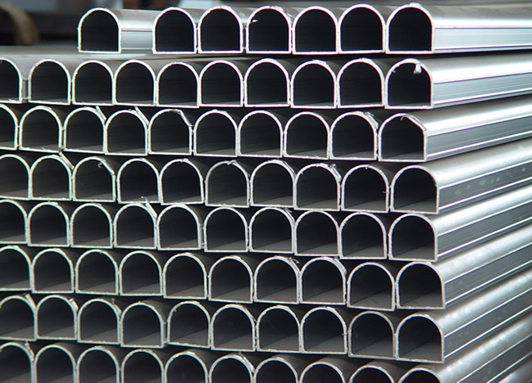
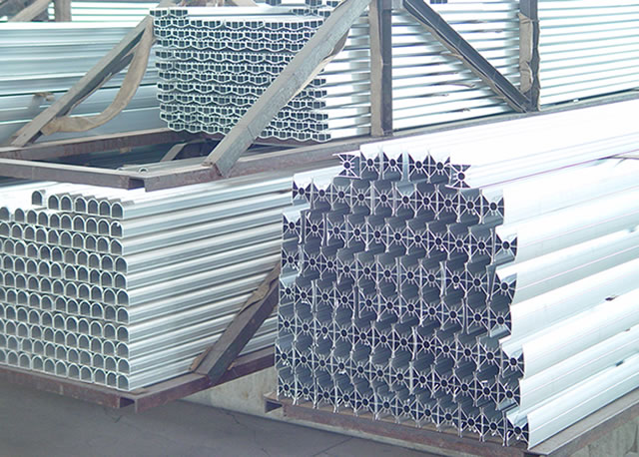
2.3 Aluminum Products
Profiles by melting extrusion can be widely used in construction
and heat radiation industry…. etc.

Slide 24
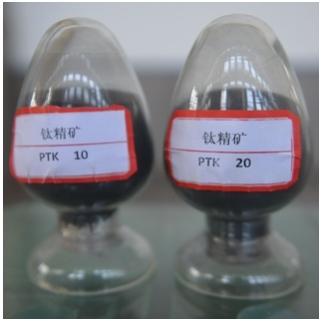
3.Other Resources
Britway Recources are also engaged in Titanium related products by taking advantage of our close connections with enterprises in Panzhihua area, south west China , where there is rich resources in Titanium. The major products are ilmenite, Titanium Concentrates, high titanium slag and titanium pigment and so on.
3.1 Titanium Concentrate
Titanium concentrates are selected from ilmenite and Vanadium Titano Magnetite .It is preliminary and important materials in titanium industry. In China the Titanium concentrates are mainly distributed in Yunnan and Sichuan province, the concentrated produced in these area are famous for its high content of Fe and less impurities, are important materials for deep melting and further process.

Slide 25
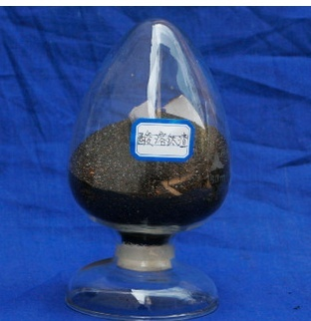
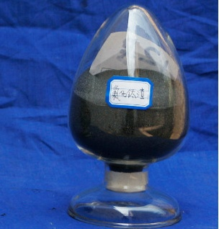
3.2 High Titanium Slag
High titanium slag is commonly known as titanium concentrate and it is the
important material for the production of titanic chloride, titanium pigment and
titanium sponge. According to the content of titanium and main application, the
High titanium slag can be divided into acid soluble titanium slag and titanium
Chloride residue.

Slide 26
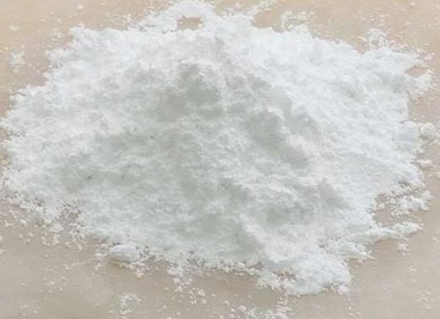
3.3 Titanium pigment
The main component of titanium pigment is TiO2,it is an important brighteners and widely used in chemical, cosmetics and food industry and so on.

Slide 27
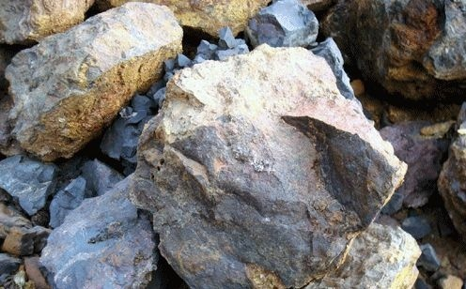
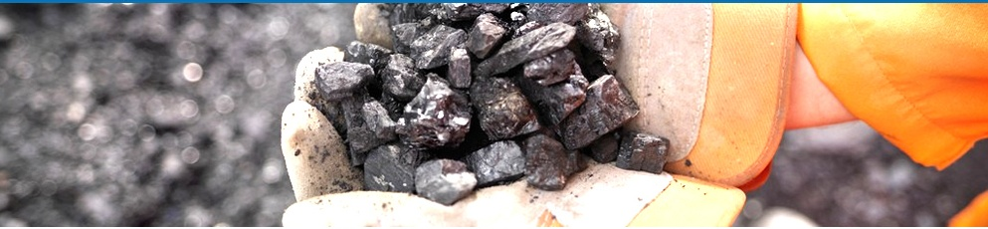
In addition, we are involved in other mineral resources like iron ore, copper etc.

